Slide 1

Ruby
Sam Shaw

Slide 2

Background
Released: 1995
Created by: Yukihiro Matsumoto
Created from:
Perl, Smalltalk, Eiffel, Ada, and Lisp
Filled need for natively OO scripting Language
Significant growth as a result of Ruby on Rails (2005)
Notes:
Conceived in 1993, Released in 1995
Perl had the smell of a toy language and the OO features of Python felt tacked on

Slide 3
“Often people, especially computer engineers, focus on the machines. They think, "By doing this, the machine will run fast. By doing this, the machine will run more effectively...but in fact we need to focus on humans, on how humans care about doing programming or operating the application of the machines.

Slide 4
Significant Releases
Ruby 0.95
1995
First public release
Already had many features
OO, classes/ inheritance, iterators, exception handling, etc.
Ruby 2.0
2013
#to_h → converts objects to Hashes
Method Keyword Arguments
Method for extending classes
Ruby 2.6
2018
Added (experimental) just in time compiler
Improved Performance (x1.7 in certain benchmarks)
Ruby 3.0
2020
Switched to Just-In-Time Compiler
Notes:
Just-in-time compilation means compiling while the program is running, not before
Keyword Arguments allow you to switch the order that parameters are passed into a function IF you define them by their variable name: function(project = ”homework”, name = “Sam Shaw”)
Hash is like an Array of key/value pairs {[name, “Sam”][age, 20]

Slide 5
Ruby on Rails
Released: 2004
Web Framework written in Ruby
Created by: David Hansson
Combines easy low-punctuation ruby with Rails web development framework
Some Ruby-on-Rails Applications
Github
Soundcloud
Twitch
Instacart
Notes:
Github, Airbnb,

Slide 6
Classification
Dynamically Typed (Duck typing)
Multi-Paradigm:
Object-Oriented
Imperative
Functional
Generic
Principles followed:
Abstraction
Information Hiding
Portability
Simplicity
Notes:
Duck typing: If a variable appears to be of a certain type, it will be treated as though it is of that type
Reflective, Imperative, Functional,

Slide 7
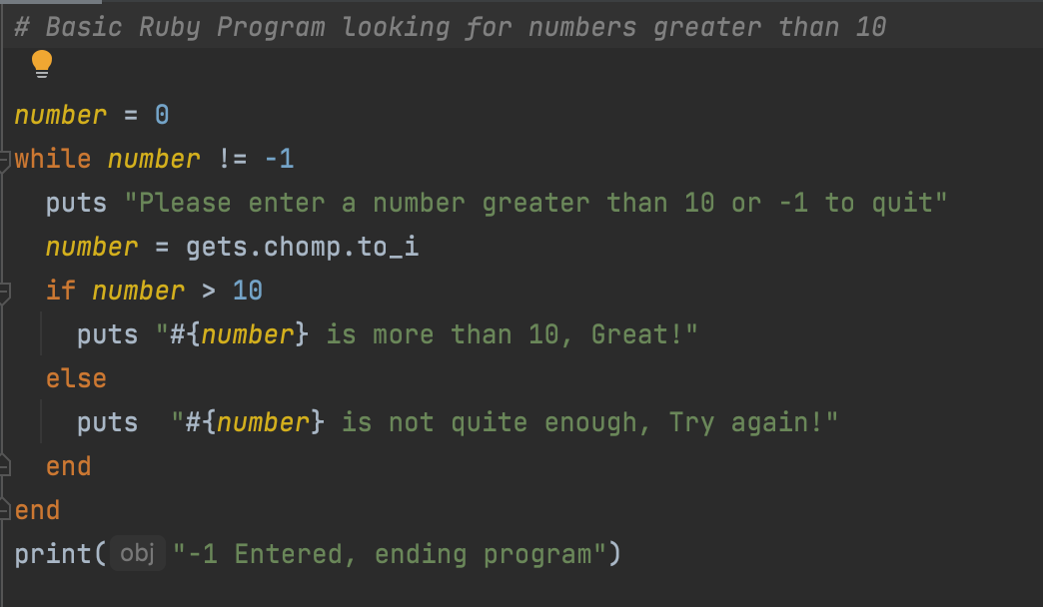
Code Sample

Slide 8
Scoring
Readability
[4.5/5]
Writability
[5/5]
Reliability
[5/5]
Cost
[2.5/5]
Overall
[17/20]
Notes:
Ruby is a very slow language, marginally quicker than Python and Perl, but far slower than languages like C and even Java. However, it is a very fast language to learn and write and obviously it’s free.
5/5 no signs of reliability problems, and unlike which Perl is based on it does warn about invalid IO or system calls

Slide 9
Sources
https://www.ruby-lang.org/en/about/
https://ruby-doc.org/docs/ruby-doc-bundle/FAQ/FAQ.html
https://thenewstack.io/which-programming-languages-use-the-least-electricity/

